Slide 1
Greenbay project part 4
Kevin Jacobson, Tim Pugh, Elijah Rich-Wimmer, Jason Larson, Scot Lambert

Slide 2
Demo of query #2 level 3 co-authors & query #3 co-author distance
Query 2 - Recursive co-authors: How many Level 3 co-authors does Michael Stonebraker have? How many does David DeWitt have?
Query 3 - Co-author distance: At what level is Moshe Vardi from Michael J. Franklin?
CouchDB Demo
Notes:
Tim will present

Slide 3
Data model critique: Before
Publication:
_id = unique string
Type: string
Authors: Integer Array
Data: (Abstraction)
Citations*: Integer Array
Works Cited By: Integer Array
Papers included*: Integer
year, title, url (if type == www)
volume, year, title, conference, publisher, isbn, series (if type == proceedings)
volume, year, title, publisher, isbn, series, collection_papers (if type == book)
title, publisher (if type == journal)
Title, in_collection, in_journal, in_proceedings (if type == paper)
year, title, publisher, isbn, series, school (if type == phdthesis)
year, title, school (if type == msthesis)
Person:
_id = unique integer
Name: string
Type: string = “person”
Works written: string array
Works Edited: string array
Notes:
Elijah will present on data model critique.

Slide 4
Data model critique: After
Publication:
_id = unique string
Type: string
Authors: Integer Array
Data: (Abstraction)
Citations*: Integer Array
Works Cited By: Integer Array
Papers included*: Integer
year, title, url (if type == www)
volume, year, title, conference, publisher, isbn, series (if type == proceedings)
volume, year, title, publisher, isbn, series, collection_papers (if type == book)
title, publisher (if type == journal)
Title, in_collection, in_journal, in_proceedings (if type == paper)
year, title, publisher, isbn, series, school (if type == phdthesis)
year, title, school (if type == msthesis)
Person:
_id = unique integer
Name: string
Type: string = “person”
Works written: string array
Works Edited: string array
Notes:
Elijah will present on data model critique.

Slide 5
Data model critique
Conclusion: Model is effective for implemented queries
No need to risk further changes.
Gains in performance and locality justifies the cost in storage.
Model is weak for graph traversals and updates
Map functions mainly used to generated these connections.
However, Couchdb can easily reload the data into another model.
If faced with heavier graph type processing
Create a second data model in a separate instance (easily/well supported by CouchDB).
Notes:
Elijah Would like to present on this. (Did anyone else take it?)

Slide 6
Query plan critique
CouchDB operates differently from traditional RDBMS’s in that you have basically two ways to access your data:
Key lookup on the document associated with the key
http://35.233.173.113:5984/publication/100007
Define map reduce jobs that ultimately create views which create a new set of indexes to access the data
Based on this behavior there really is not a query plan (and we could not find one) to critique.
If you are experiencing performance problems you will need to look at your map reduce strategy and modify it appropriately.
Notes:
Kevin

Slide 7
Lessons learned
TURN OFF YOUR GOOGLE BILLING
And then double check that it is really off
Google Cloud (and probably all cloud platforms) has so much configurability available that it can be difficult to understand all of the various options
It would be nice if there was an option available with a single or maybe two clicks that would give you some sort of small functioning environment (CPU, storage, …) and then let you add to those resources as needed
Spend extra time up front in the design it will pay dividends at implementation time
We divided the dataset into /person/ and /publication/ “DBs”.
Could have put everything into /dblp/ to improve implementation of some queries and still make use of our data model.
Notes:
Scot

Slide 8
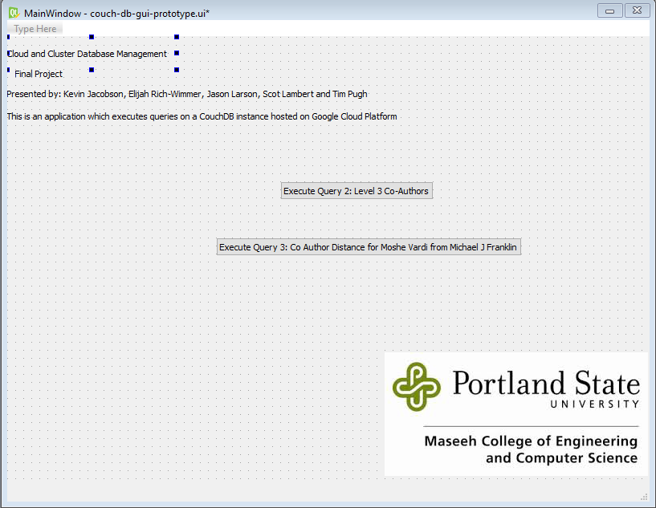
Advice to those who follow
Our advice is somewhat limited since we only worked with CouchDB and no other products.
That said, we found this to be a very easy product to work with using our Document Model design.
Also, given CouchDB’s support for copying the data to a new instance which could be using a different data model, if feels like there is good insurance for a limited pain experience if you need to implement a new requirement resulting from a design mistake, requirements change or other event
Learn and Research: GUI Prototype Demo
Notes:
Tim

Slide 9
Thank you

Slide 10
Link to code in Github
Project Repo: https://github.com/ElijahRW/CS_410_CCDM_Team_Project CouchDB Official:
https://github.com/apache/couchdb
CouchDB new Web Interface:
https://github.com/apache/couchdb-fauxton

